Slide 1

Neural Substrates of Attention and Awareness
Dan Birman
Gardner Lab
Frisem – 2015-04-17

Slide 4


Slide 5
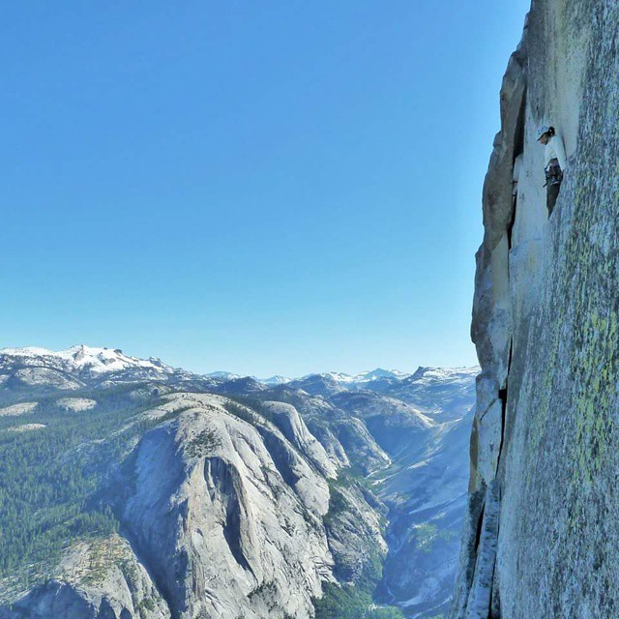

Slide 7







Slide 8
Neural Substrates of Attention and Awareness
Dan Birman
Gardner Lab
Frisem – 2015-04-17

Slide 11


Slide 12


Slide 13
Attention as a Pre-Requisite to Awareness
Dual task designs “pull” attention to one task, causing inattentional blindness for other stimuli.
“we believe […] there is no conscious perception without attention” (Mack & Rock, 1998)

Slide 14
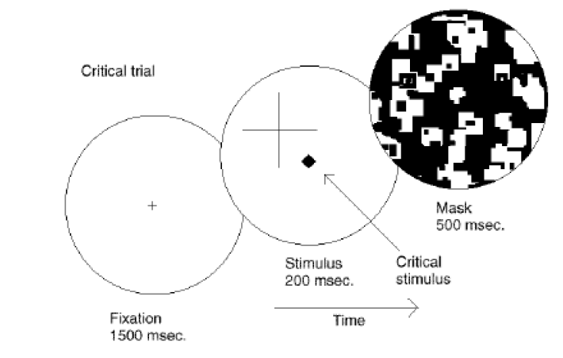
Attention as a Pre-Requisite to Awareness
Dual task designs “pull” attention to one task, causing inattentional blindness for other stimuli.
“we believe […] there is no conscious perception without attention” (Mack & Rock, 1998)
Mack & Rock, 1998
Notes:
There is one situation where attention (seems) to not be a pre-requisite for awareness

Slide 15
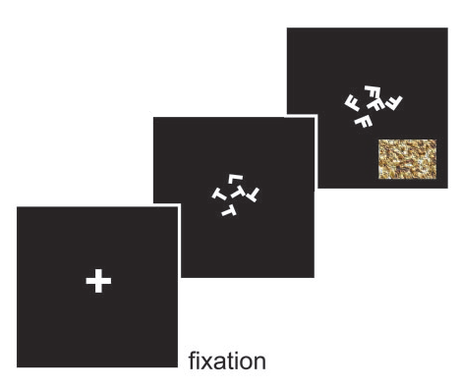
Gist Perception
“The close relationship between attention and
consciousness has led many scholars to conflate these processes“ (Koch & Tsuchiya, 2006)
Li et al., 2002

Slide 16
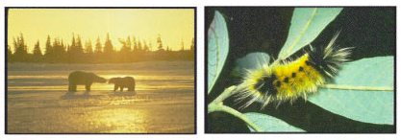
Gist Perception
“The close relationship between attention and
consciousness has led many scholars to conflate these processes“ (Koch & Tsuchiya, 2006)
Li et al., 2002

Slide 17
Gist Perception vs. Inattentional Blindness

Slide 18
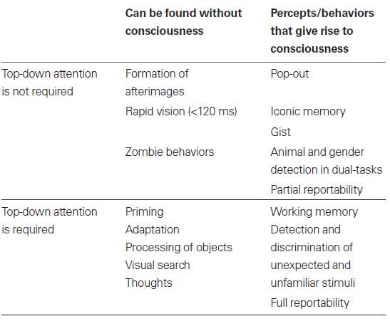
P
Perception of Stimulus:
Unaware
Aware
Unattended
Stimulus Is:
A
Attended

Slide 19
P
Perception of Stimulus:
Unaware
Aware
Unattended
Stimulus Is:
A
Attended
Normal Vision

Slide 20
P
Perception of Stimulus:
Unaware
Aware
Unattended
Gist Perception
Stimulus Is:
A
Attended
Normal Vision

Slide 21
P
Perception of Stimulus:
Unaware
Aware
Unattended
Inattentional
Blindness
Gist Perception
Stimulus Is:
A
Attended
Normal Vision

Slide 22
P
Jumble of Phenomena
Perception of Stimulus:
Unaware
Aware
Unattended
Inattentional
Blindness
Gist Perception
Stimulus Is:
A
Attended
Continuous Flash
Suppression
Normal Vision

Slide 23
P
Perception of Stimulus:
Unaware
Aware
Unattended
Inattentional
Blindness
Gist Perception
Stimulus Is:
A
Attended
Continuous Flash
Suppression
Normal Vision

Slide 24
P
Perception of Stimulus:
Unaware
Aware
Catch:
Unattended
Inattentional
Blindness
Gist Perception
Stimulus Is:
A
Cued:
Attended
Continuous Flash
Suppression
Normal Vision

Slide 25
P
Perception of Stimulus:
Perceptually Identical:
Unaware
Perceptually Distinct:
Aware
Catch:
Unattended
Stimulus Is:
A
Cued:
Attended

Slide 26
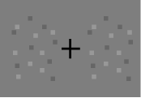
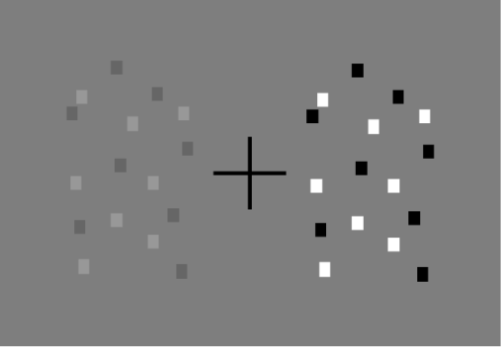
P
Perception of Stimulus:
Perceptually Identical:
Unaware
Perceptually Distinct:
Aware
Catch:
Unattended
Stimulus Is:
A
Cued:
Attended

Slide 27
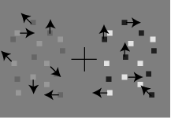
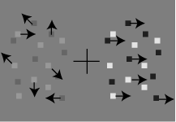
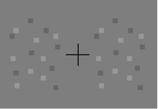
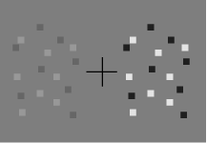
P
Perception of Stimulus:
Perceptually Identical:
Unaware
Perceptually Distinct:
Aware
Catch: Coherence
Unattended
Stimulus Is:
A
Cued: Contrast
Attended

Slide 28
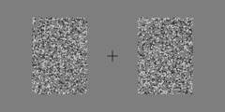
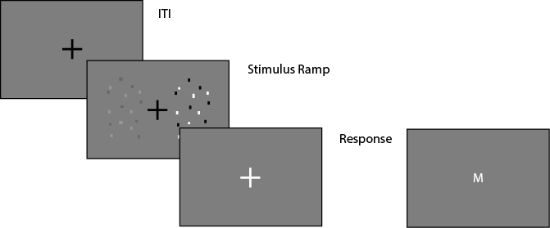
Task Design

Slide 29
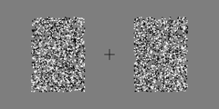
Task Design

Slide 30
P
Perception of Stimulus:
Perceptually Identical:
Unaware
Perceptually Distinct:
Aware
Catch: Coherence
Unattended
Stimulus Is:
A
Cued: Contrast
Attended

Slide 31
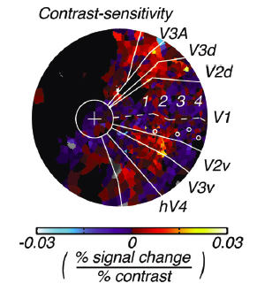
Contrast
Notes:
First attempt: dual

Slide 32
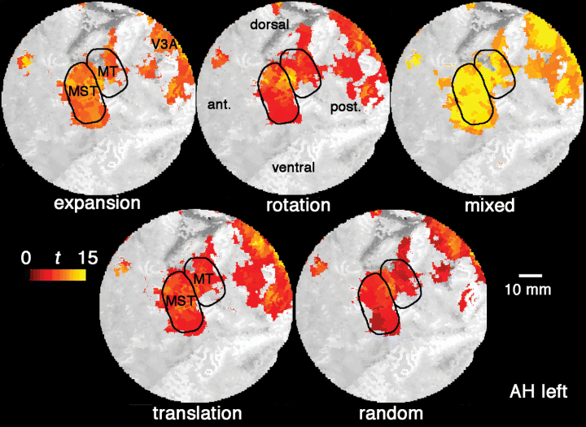
Contrast and Coherence
Notes:
First attempt: dual

Slide 33
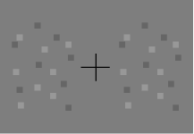
Neural Substrate of Awareness
100%
Performance (%)
50%
.44 .88 1.75 3.5 7 14 28
Difference in Stimulus Strength

Slide 34
Neural Substrate of Awareness
Performance (%)
Difference in Stimulus Strength

Slide 35
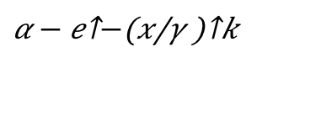
Neural Substrate of Awareness
$$α − e^{−{\left(\frac{x}{γ}\right)}^{k}}$$
Performance (%)
Difference in Stimulus Strength

Slide 36
Neural Substrate of Awareness
~80% Performance
Performance (%)
11% Contrast
Discrimination Threshold
Difference in Stimulus Strength

Slide 37
Neural Substrate of Awareness

Slide 38
Neural Substrate of Awareness

Slide 39
Neural Substrate of Awareness

Slide 40
P
Perceptually Identical:
Unaware
Perceptually Distinct:
Aware
Catch: Coherence
Unattended
A
Cued: Contrast
Attended

Slide 41
P
Perceptually Identical:
Unaware
Perceptually Distinct:
Aware
Catch: Coherence
Unattended
A
Cued: Contrast
Attended

Slide 42
Effect of Attention

Slide 43
Effect of Attention
Unaware:
No Discrimination
Aware:
Can Discriminate

Slide 44
Effect of Attention
Unaware:
No Discrimination
Aware:
Can Discriminate

Slide 45
Effect of Attention

Slide 46

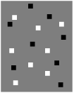
Effect of Attention
Bold Response Magnitude

Slide 47
Effect of Attention
Bold Response Magnitude

Slide 48
Effect of Attention
Bold Response Magnitude

Slide 49
Effect of Attention
Bold Response Magnitude

Slide 50
Effect of Attention
Bold Response Magnitude

Slide 51
Effect of Attention
Bold Response Magnitude

Slide 52
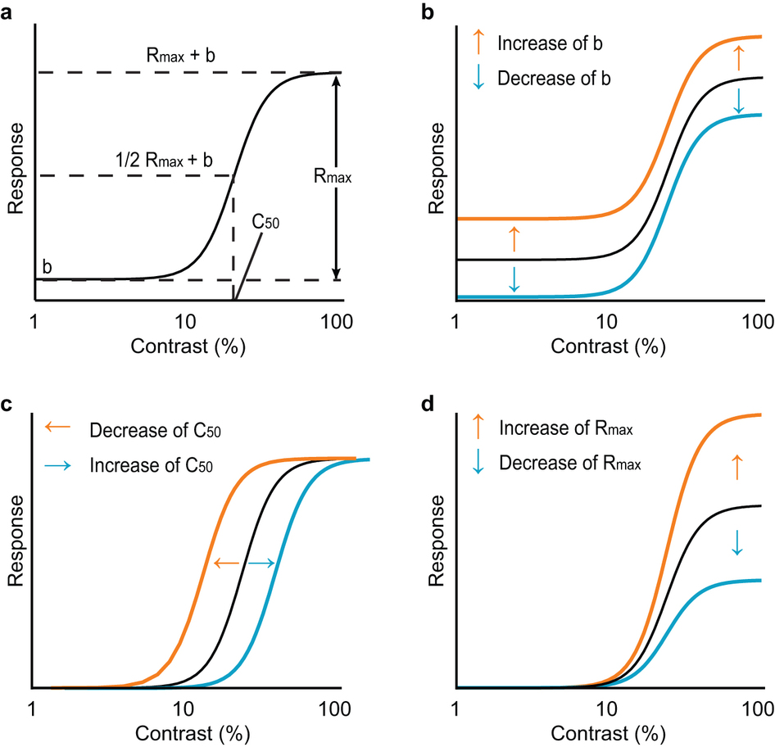
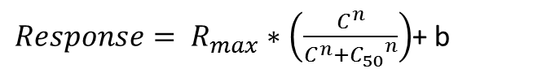
$Response= R_{max}∗\left(\frac{C^{n}}{C^{n}+{C_{50}}^{n}}\right)$+ b
Baseline Shift
Response Gain
Contrast Gain
Soma et al. 2013

Slide 53
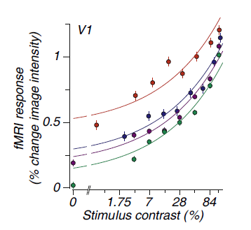
Neural Substrate of Attention
BOLD Magnitude
Attended
Unattended
Pestilli et al., 2011

Slide 54
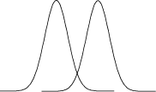
Neural Substrate of Attention
Bold Response Magnitude
Attended
Unattended

Slide 55
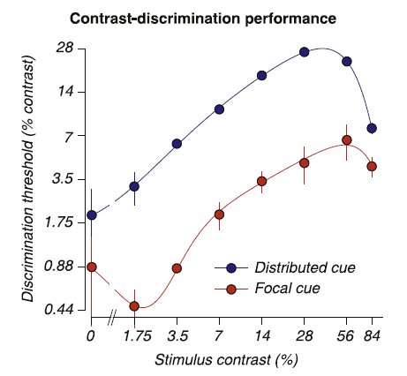
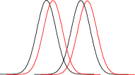
Neural Substrate of Attention
Attended
Unattended
Pestilli et al., 2011

Slide 56
Neural Substrate of Attention
Attended
Unattended
Pestilli et al., 2011

Slide 57
Neural Substrate of Attention
Attended
Unattended

Slide 58
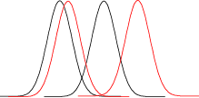
Neural Substrate of Attention
Attended
Unattended

Slide 59
Neural Substrate of Attention
Attended
Unattended

Slide 60
Neural Substrate of Attention
Behavioral Performance ←→ BOLD Magnitude
Attended
Unattended
Pestilli et al., 2011

Slide 61
Neural Substrate of Attention
Attended
Unattended
7%
14%

Slide 62
Neural Substrate of Attention
Psychophysical Threshold: ~80% Performance
Attended
Unattended
7%
14%

Slide 63
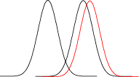
Neural Substrate of Attention
Attended
Unattended
7%
14%

Slide 64
Neural Substrate of Attention
Attended
Unattended
7%
14%
Pestilli et al., 2011

Slide 65
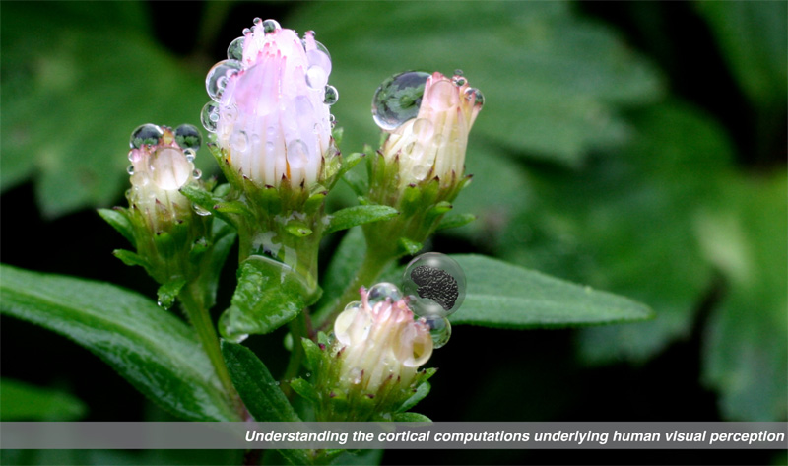

Gardner Lab @ Stanford University
Thank You!
Justin Gardner
Steeve Laquitaine
1st Year Cohort

Slide 66
Behavior in the Scanner
Outside
Inside Scanner

